Slide 1

ILP 2022 – W1S1 Getting started
Matthieu DE MARI – Singapore University of Technology and Design

Slide 2
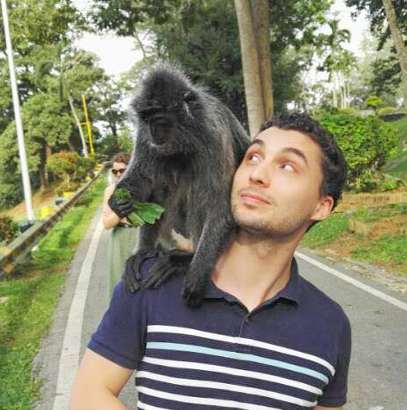
A quick word about me
Matthieu (Matt) DE MARI
Lecturer at SUTD (Python, Deep Learning, AI, and more)
Information Systems Technology and Design (ISTD) pillar/faculty
PhD from CentraleSupelec (France)
Email: matthieu_demari@sutd.edu.sg
Office @ SUTD: 1.702.27

Slide 3
Outline (Week1, Session1 – W1S1)
About this course: syllabus, objective, eDimension, practices, etc.
What is programming?
Key concepts about programming and computer science.
Programming languages.
Installing and configuring Python, and extra packages.
Our first programs!

Slide 4
Objectives of this Summer School
Objectives:
Give the students an introduction to Computer Science,
Programming,
and Python.
Delivery:
3x 2h-lessons per week
Lessons include a bit of theory (PPT slides) and practice activities (in Jupyter Notebooks)

Slide 5
Topics
Week1 Session 1 (W1S1): Getting started, key concepts, configuring and installing Python
W1S2: Variables, math operators, comments, printing and getting
W1S3: None type, Boolean types and functions
W2S1: More practice on functions
W2S2: If, elif, else, while, break statements
W2S3: More practice on if, elif, else, while
W3S1: For loops, generators and recursion
W3S2: The list type
W3S3: Advanced concepts on for loops and list type

Slide 6
Topics
W4S1: Debugging, errors, asserts and time
W4S2: Numpy library (part 1) and imports
W5S1: More on Numpy (part2), randomness
W5S2: Everything about strings
W5S3: Dictionaries and object-oriented thinking
W6S1: Object-oriented programming (part 1)
W6S2: Object-oriented programming (part 2)
W6S3: Recap and mini-project!

Slide 7
Edimension
Teaching materials
PPT/PDF contain the lecture materials (PPT preferred)
Activities notebooks and their answers
The teaching materials will be uploaded on eDimension and made available on the same day.
https://edimension.sutd.edu.sg/

Slide 8
Homeworks, extras and exams
In-class activities: activities, done together during online lessons. Solutions are provided on other notebooks.
Homeworks? Nope.
But
Extra practice: basic exercises and notions, to practice the concepts seen in class a bit more.
Extra challenges: advanced versions of the activities discussed in class.
None of them are mandatory. Solutions are provided (except for challenges!)

Slide 9
Plot twist: GAMIFICATION
“Games are a good way of thinking about real problems. I use games in all my courses […] because things you have played with are things you remember.”
- Jarrett Walker, international consultant in public transit network design. (He also has a fantastic blog about using strategy and planning games, like MiniMetro and SimCity to explain and understand notions of transportation network and city design) http://humantransit.org/2014/12/learning-how-transit-works-from-mini-metro.html

Slide 10
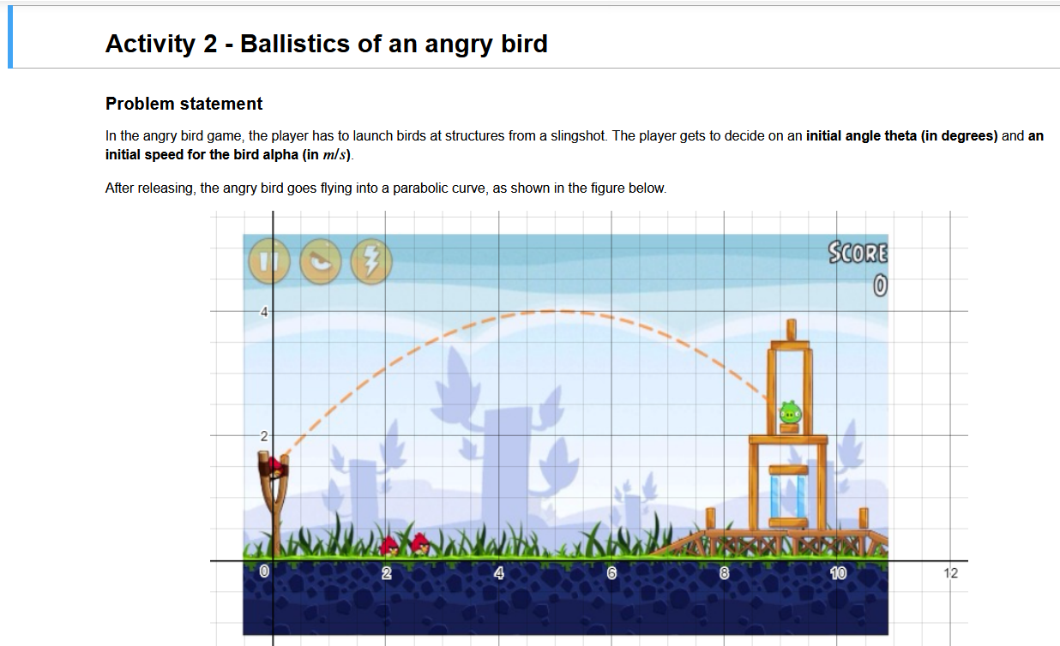
Plot twist: GAMIFICATION

Slide 11
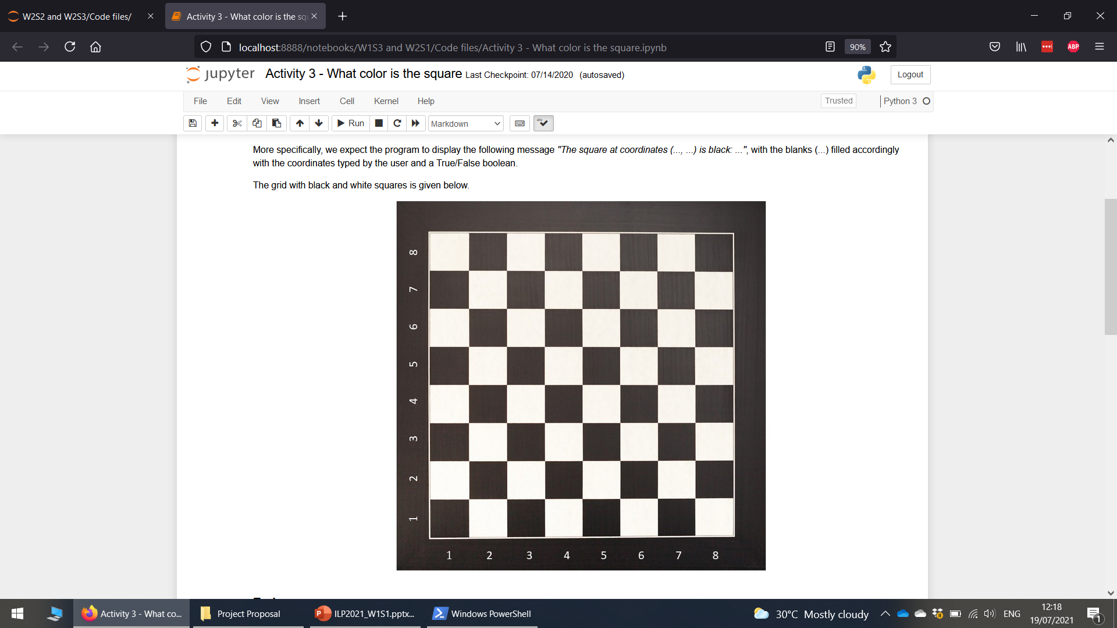
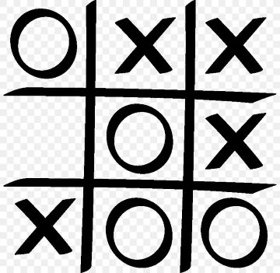
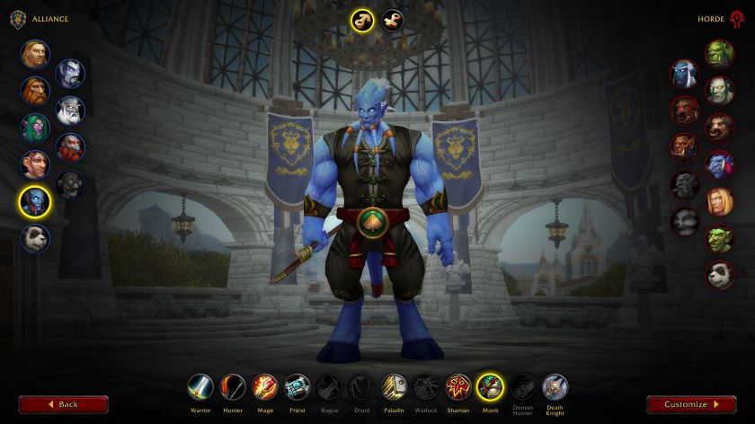
Plot twist: GAMIFICATION

Slide 12
Survey
During this class, I might often use online “surveys”.
These help me check your understanding of this class and adjust accordingly… Please fill them!
Speaking of... Here is your first survey: what is “programming”?
https://forms.gle/stRPXnu5ZZrjMkCw5

Slide 13
Programming: definition
Definition (Programming): Programming refers to the process of designing and building an executable computer program, to accomplish a specific computational task. It involves tasks such as
analysis,
designing algorithms,
and implementing said algorithms in a chosen programming language (a.k.a. coding).

Slide 14
Programming: definition
Definition (Programming): Programming refers to the process of designing and building an executable computer program, to accomplish a specific computational task. It involves tasks such as
analysis,
designing algorithms,
and implementing said algorithms in a chosen programming language (a.k.a. coding).
Layman definition (Programming): Programming consists of defining a sequence of instructions that the computer must follow to accomplish a task.

Slide 15


Programming: some analogies
Raw ingredients
Recipe instructions
A nice dish as a result
Think of it as a food recipe book! A recipe requires you to follow and execute a set of instructions to cook a recipe from scratch!

Slide 16
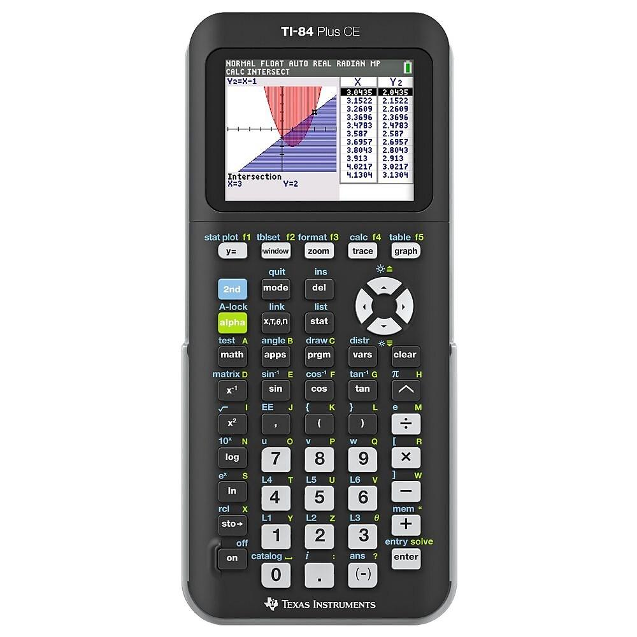
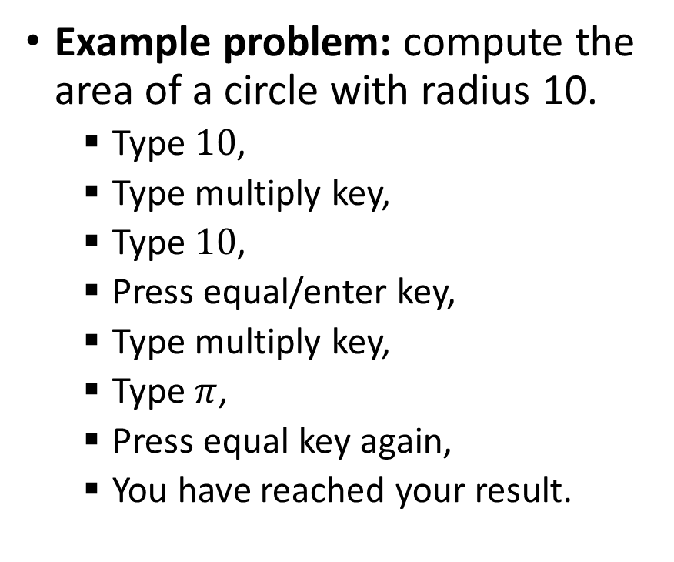
Programming: some analogies
Or a sequence of operations you would normally do on a calculator to find a result.
Example problem: compute the area of a circle with radius 10.
Type $10$,
Type multiply key,
Type $10$,
Press equal/enter key,
Type multiply key,
Type $π$,
Press equal key again,
You have reached your result.

Slide 17
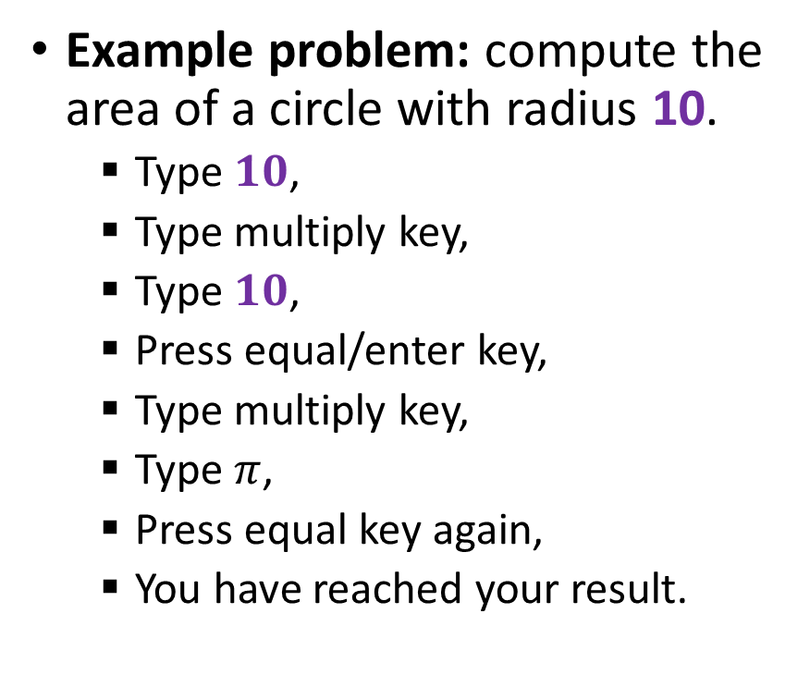
Algorithm: definition
Definition (Algorithm): An algorithm is a finite sequence of instructions, typically used to solve a class of problems or perform a computation task. When executed, on a provided set of inputs, it will proceed through a set of well-defined states and will eventually produce an output.
Example problem: compute the area of a circle with radius 10.
Type $10$,
Type multiply key,
Type $10$,
Press equal/enter key,
Type multiply key,
Type $π$,
Press equal key again,
You have reached your result.
ALGORITHM

Slide 18
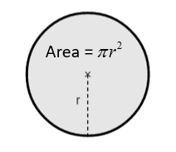
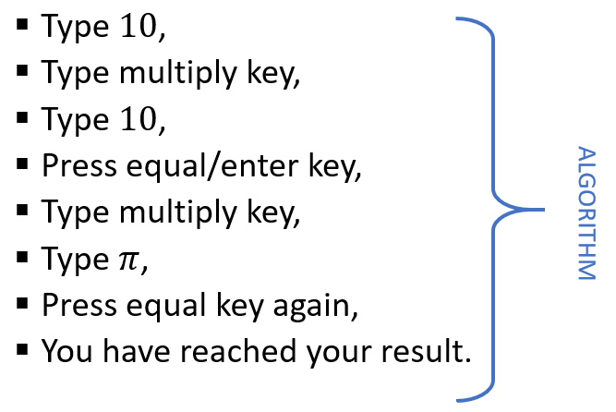


The life of a programmer
Identify a problem.
Come up with a general algorithm to solve it.
Step-by-step instructions.
Think of it as a ‘recipe’ or a ‘flowchart’.
Represent this algorithm as a program, using a chosen programming language.
Execute the program on a computer!

Slide 19
Quick question
→ Who is considered the inventor of computers and “programming”?

Slide 20
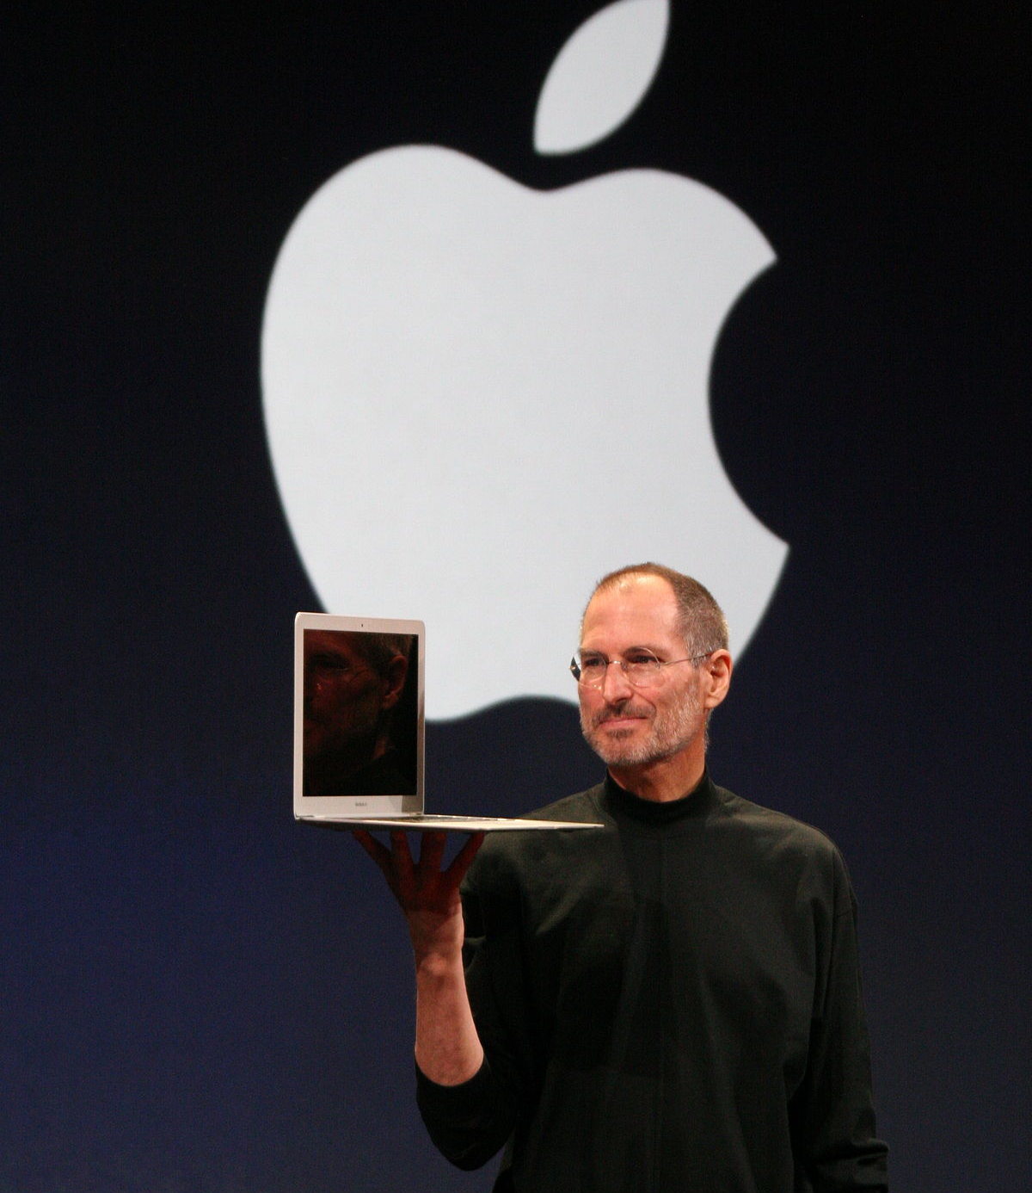
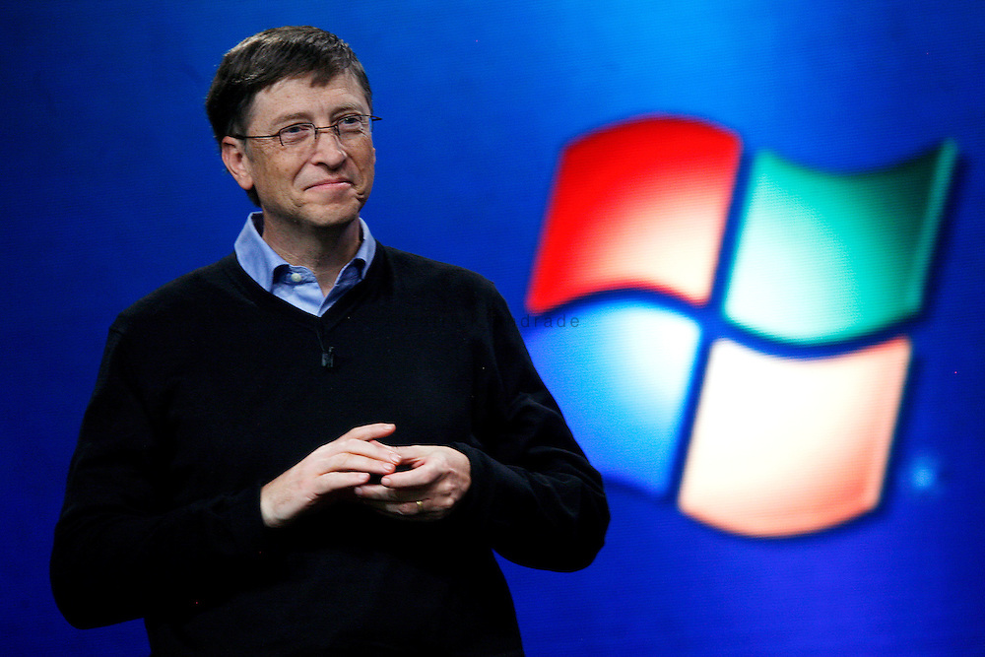
Quick question
→ Who is considered the inventor of computers and “programming”?
Hint: it is NOT one of the persons below.

Slide 21
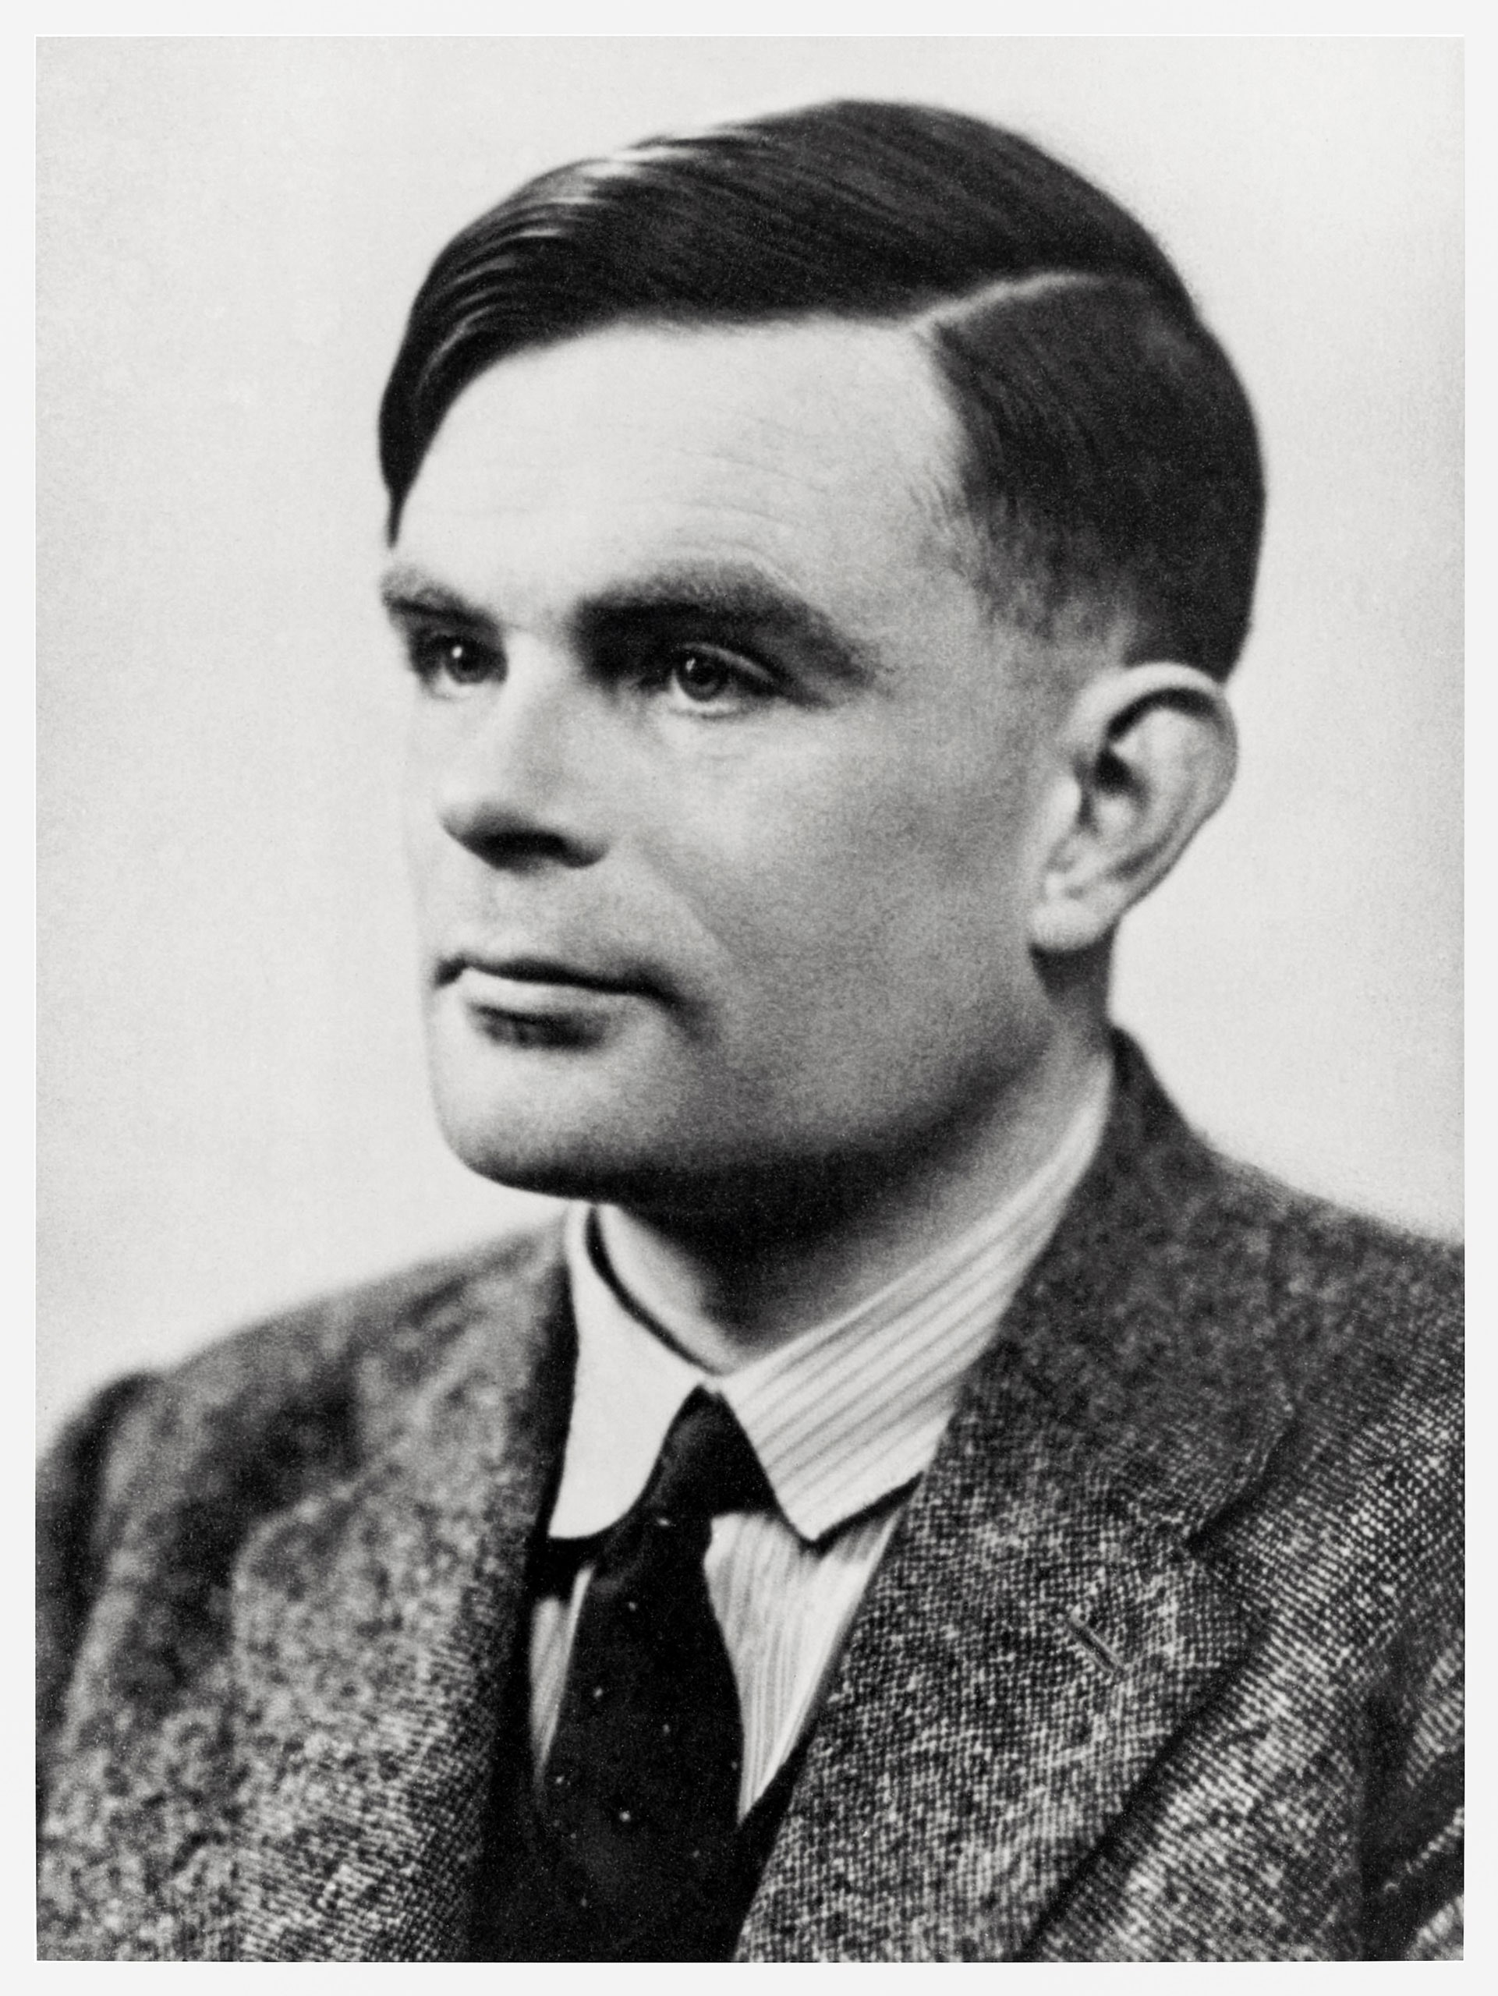
The “father” of computer science
Alan Mathison Turing (1912–1954) was an English mathematician, computer scientist, logician, cryptanalyst, philosopher, and theoretical biologist.

Slide 22
The “father” of computer science
Alan Mathison Turing (1912–1954) was an English mathematician, computer scientist, logician, cryptanalyst, philosopher, and theoretical biologist.
Turing was highly influential in the development of theoretical computer science, formalized algorithmic concepts, and created the first Turing machine, which can be considered the first model of a general-purpose computer.

Slide 23

The “father” of computer science
During World War 2, he came up with an idea of a “computer-like” machine, to decode encrypted transmissions from the German army.
Thanks to his decryption device, it has been estimated the war in Europe was shortened by more than two years and saved over 14 million lives.
Learn more about Alan Turing, by watching The Imitation Game movie.

Slide 24
About your computer
Your computer is good at doing two, and only two, things
Perform computational tasks (calculations), as described by an algorithm provided by a human to the computer.
Remember the results of these computational tasks, by storing them in its internal memory (and eventually retrieving these results later on, by accessing its memory)

Slide 25
About your computer
Your computer is good at doing two, and only two, things
Perform computational tasks (calculations), as described by an algorithm provided by a human to the computer.
Remember the results of these computational tasks, by storing them in its internal memory (and eventually retrieving these results later on, by accessing its memory)
And that is it.

Slide 26
About your computer
Your computer is good at doing two, and only two, things
Perform computational tasks (calculations), as described by an algorithm provided by a human to the computer.
Remember the results of these computational tasks, by storing them in its internal memory (and eventually retrieving these results later on, by accessing its memory)
And that is it.
And that is all you need.

Slide 27
About your computer
Your computer is good at doing two, and only two, things
Perform computational tasks (calculations), as described by an algorithm provided by a human to the computer.
Remember the results of these computational tasks, by storing them in its internal memory (and eventually retrieving these results later on, by accessing its memory)
And that is it.
And that is all you need.
Because all operations performed by computers nowadays can be broken down into combinations of both aforementioned operations.

Slide 28
The Von Neumann architecture
Central Processing Unit
Memory Unit
Output devices
Input devices
Definition (Von Neumann architecture): The Von Neumann architecture describes one of the first architectures for a computer.
Control Unit
Arithmetic/Logic Unit

Slide 29
The Von Neumann architecture
Central Processing Unit
Memory Unit
Output devices
Input devices
It first consists of a Central Processing Unit (CPU), which itself consists of…
An Arithmetic/Logic Unit (in charge of dealing with instructions, typically math operations, in binary 0/1),
And a Control Unit (in charge of the hardware and communication between different hardware elements)
Control Unit
Arithmetic/Logic Unit

Slide 30
The Von Neumann architecture
Central Processing Unit
Memory Unit
Output devices
Input devices
It also contains…
A Memory Unit (for storing and retrieving results from previous computational tasks, using binary formatting 0/1),
Control Unit
Arithmetic/Logic Unit

Slide 31
The Von Neumann architecture
Central Processing Unit
Memory Unit
Output devices
Input devices
It also contains…
A Memory Unit (for storing and retrieving results from previous computational tasks, using binary formatting 0/1),
Inputs and Outputs Devices (e.g. mouse, keyboard, screen, microphone, webcam, etc.).
Control Unit
Arithmetic/Logic Unit

Slide 32
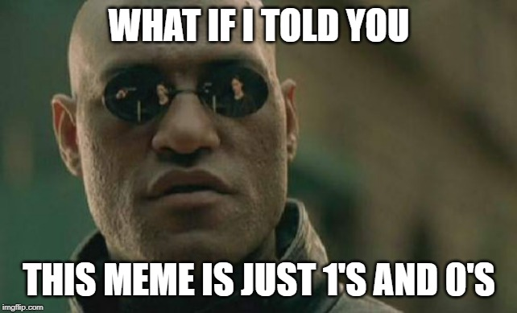
The problem of dealing with binary and the need for programming languages
Observation: in a computer, all operations (computational and memory tasks) and are performed in binary.

Slide 33
The problem of dealing with binary and the need for programming languages
Observation: in a computer, all operations (computational and memory tasks) and are performed in binary.
Problem: binary is heavy and difficult to read for humans.
Example: “Matthieu”, in binary, is “01001101 01100001 01110100 01110100 01101000 01101001 01100101 01110101“.

Slide 34
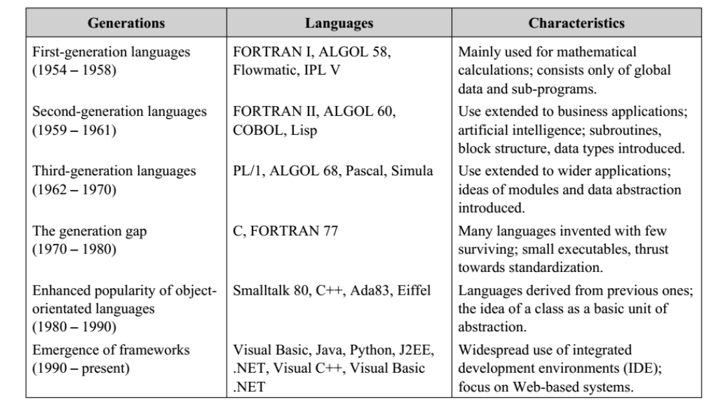
The problem of dealing with binary and the need for programming languages
Observation: in a computer, all operations (computational and memory tasks) and are performed in binary.
Solution: find an intermediate language, readable by humans, to address the computer.
High-level language: closer to human language (easy to learn)
Low-level language: closer to binary (faster, but difficult to learn)

Slide 35
The problem of dealing with binary and the need for programming languages
Observation: in a computer, all operations (computational and memory tasks) and are performed in binary.
Solution: find an intermediate language, readable by humans, to address the computer.
High-level language: closer to human language (easy to learn)
Low-level language: closer to binary (faster, but difficult to learn)

Slide 36

Python: what is it?
About Python: Python is an interpreted, high-level, general-purpose programming language.
Created by Guido van Rossum and first released in 1991.
Currently on its v3, since 2008.
Python's design philosophy emphasizes code readability.
Its language constructs aim to help programmers write clear, logical code for small and large-scale projects.

Slide 37
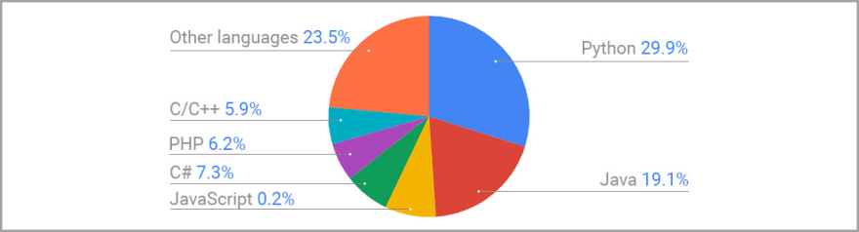
Why learn Python?
High-level language: easy to write and read, and therefore well-suited for beginners.
Wide variety of packages: can be used for multiple purposes (computer software, phone apps, video games, web, etc.)
Dynamic typing: in layman terms, Python is able to manage the data saved to memory, in an automated and efficient fashion, without human intervention.
Python is the #1 language for data science and AI at the moment: several frameworks such as Tensorflow (Google AI), Pytorch (widely used in academic research on AI), etc.

Slide 38
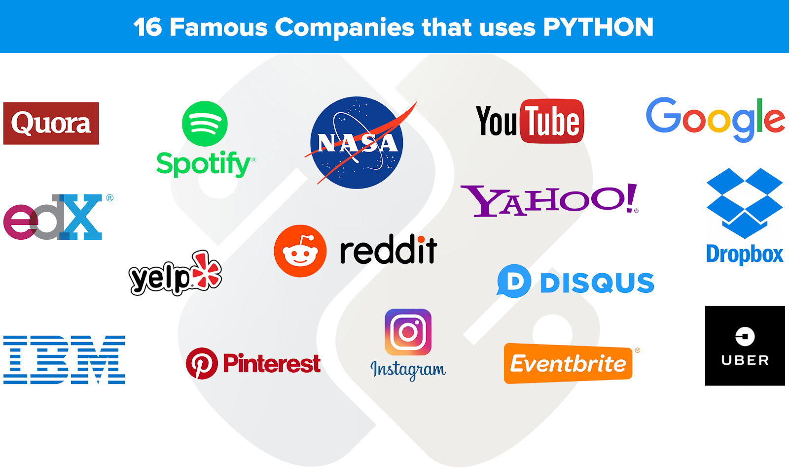
Why learn Python?
Python is widely used in IT companies.
Also, high interoperability with other languages: Jumping to or including another language (Java, C, SQL, etc.) is easy, once you know Python.
→ Overall, Python is a good entry point for beginners in both programming and computer science, and therefore the first language we teach in SUTD.

Slide 39
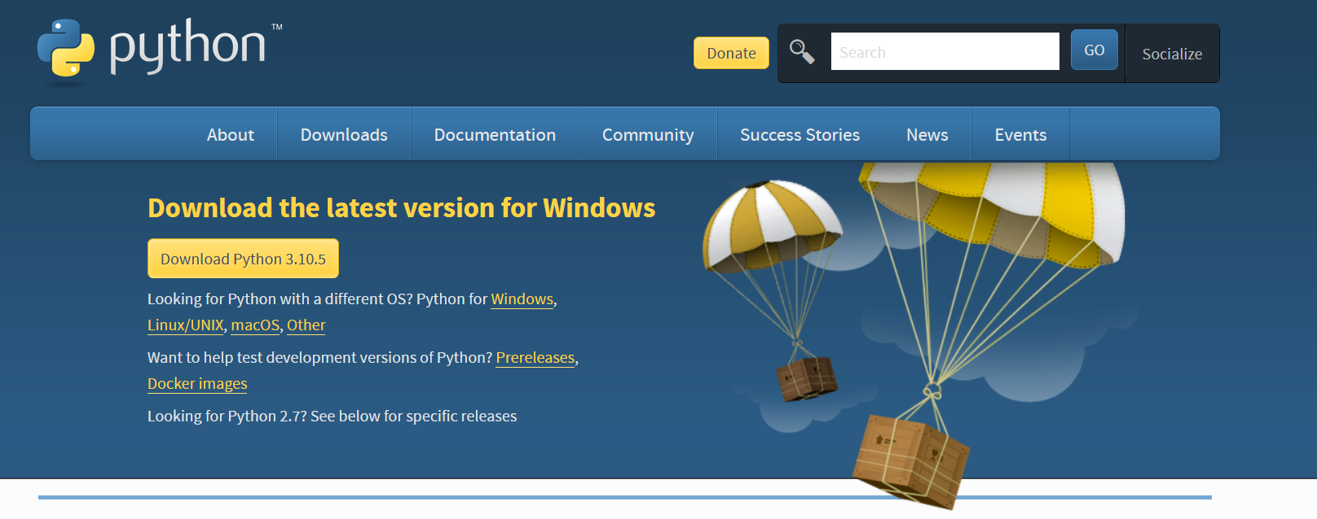
Installing Python
Install it now!
In this class, we will use Python 3.10(.5) (latest stable version available on the 12th of July 2022).
Download it here (for 32/64-bit Windows and Mac users, Linux users can get it via apt-get or SoftwareCenter)
https://www.python.org/downloads/

Slide 40
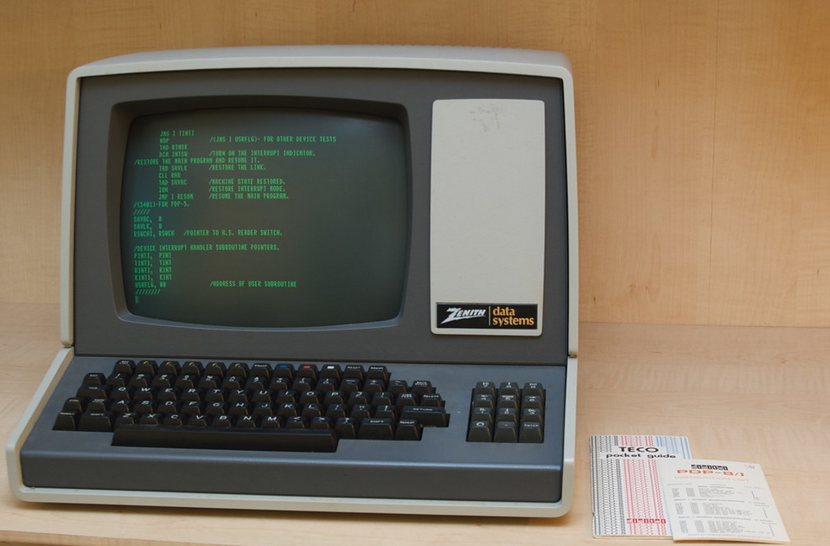
The Console/Terminal/Shell/Bash
Definition (Console, Terminal, Shell, or Bash):
The console is a text prompt expecting commands, which can be used to communicate with your computer.
(And in the early days of computers, it was the only way to communicate with them!)

Slide 41
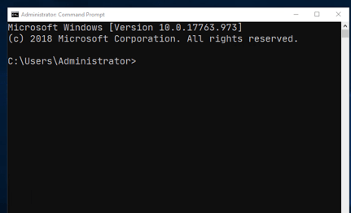
The Console/Terminal/Shell/Bash
Definition (Console, Terminal, Shell, or Bash):
The console is a text prompt expecting commands, which can be used to communicate with your computer.
Nowadays, your Operating System (OS) provides an easier and more user-friendly way to communicate with your computer and “hides” the need for console.
But consoles are still there, hidden somewhere in your computers anyway!

Slide 42
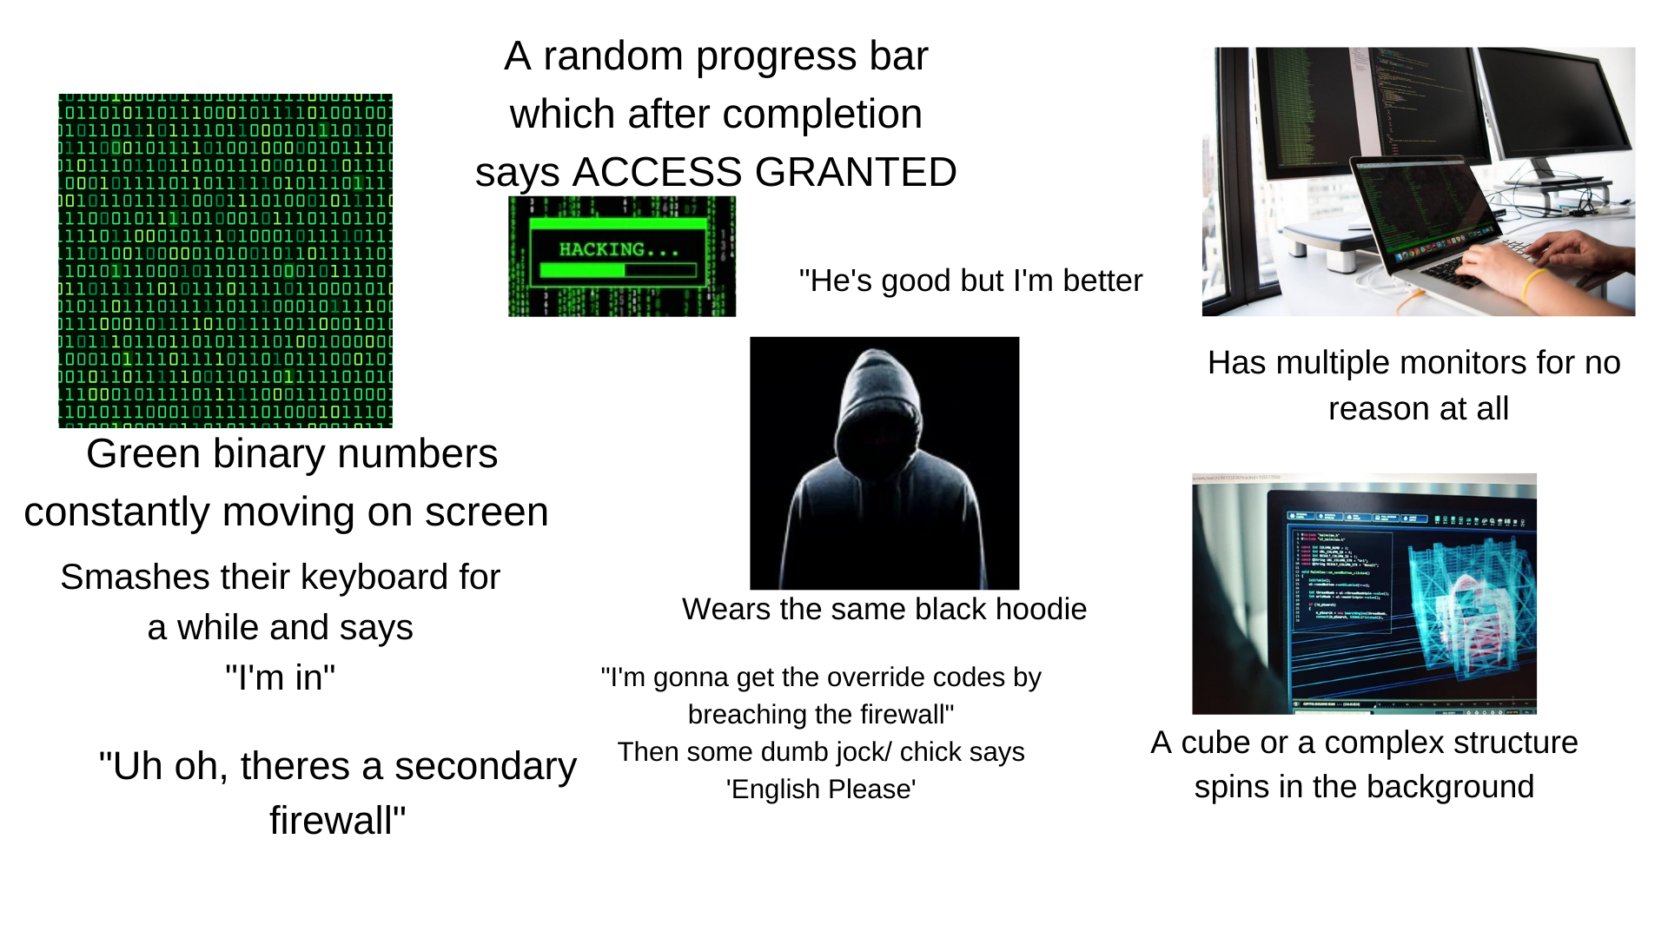
The Console/Terminal/Shell/Bash
Definition (Console, Terminal, Shell, or Bash):
The console is a text prompt expecting commands, which can be used to communicate with your computer.
Nowadays, your Operating System (OS) provides an easier and more user-friendly way to communicate with your computer and “hides” the need for console.
(Typically, you see consoles all the time in computer/hacker movies.)
Hacker in movies starter pack

Slide 43
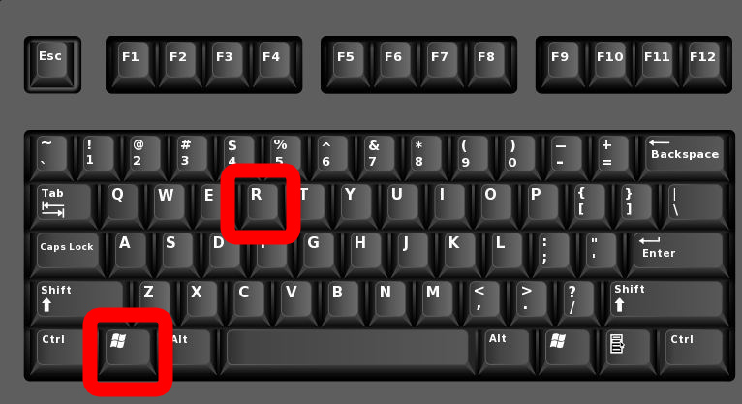
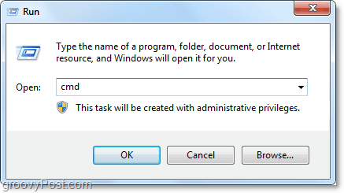
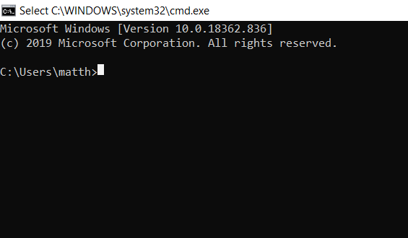
Opening a console (Windows)
Check your installation has completed appropriately, by trying to open a console.
Windows: the cool way.
Press simultaneously Windows key + R,
then type cmd (which is short for command console), and press Enter.

Slide 44
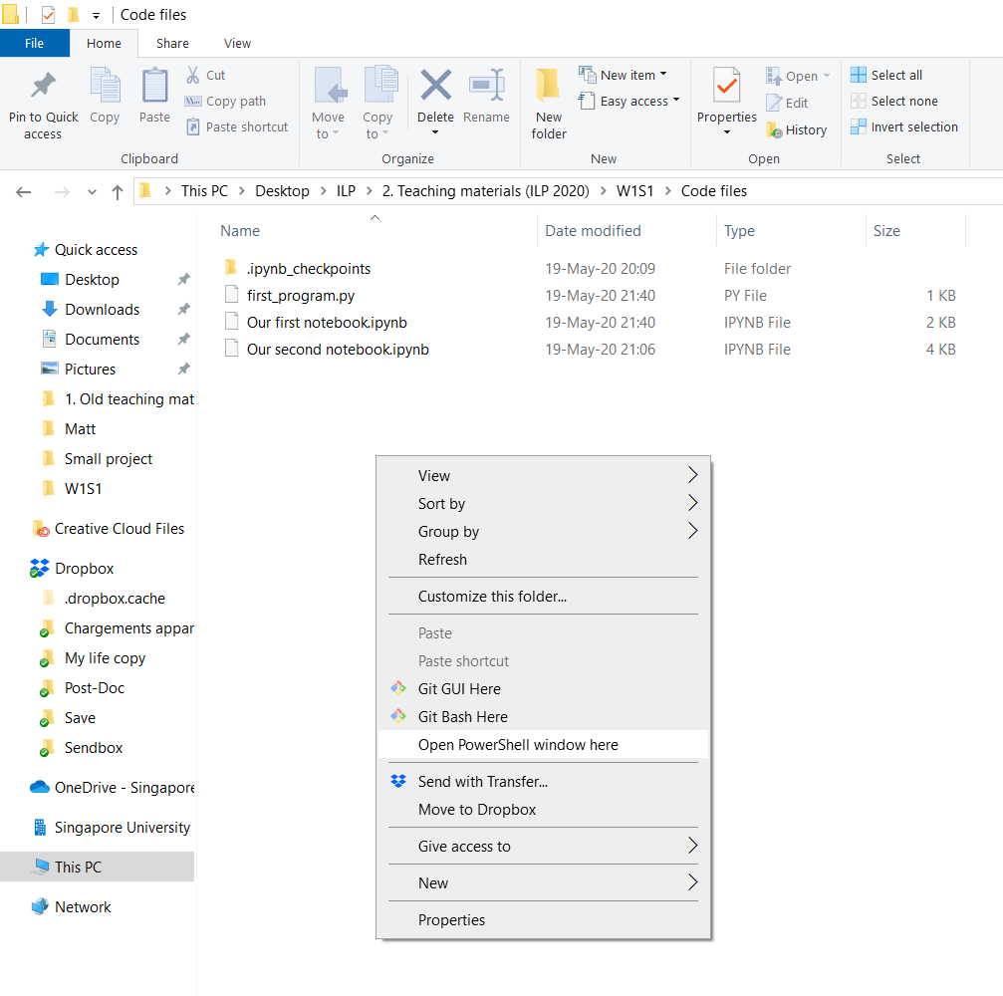
Opening a console (Windows – option 2)
Windows option 2: faster and more convenient way, in my opinion
Open an explorer window/file manager window in the folder you attempt to work in.
Hold shift and right-click in an empty space of the explorer window.
Choose “Open Powershell window here”.

Slide 45
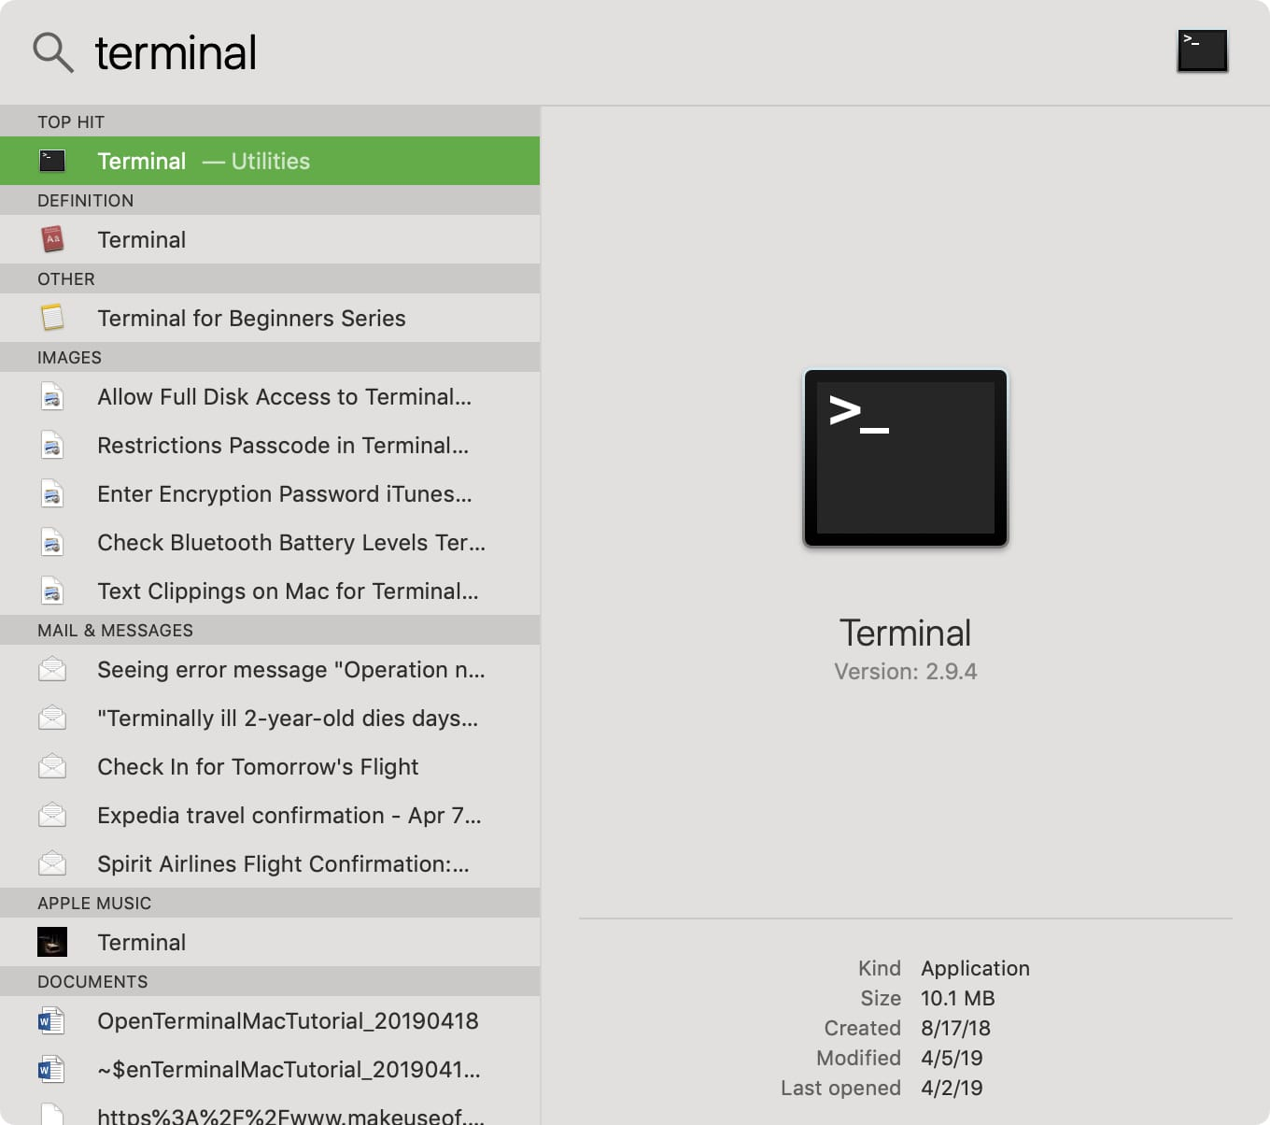
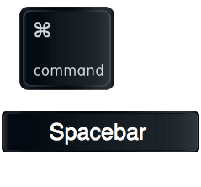
Opening a console (Mac OS)
Mac: roughly the same procedure
Press simultaneously Command key + Space,
Then type Terminal,
It should appear as your top result, click it

Slide 46
OS mode vs. Python mode
After installing Python, you may use the console to type Windows/Mac/OS commands (a.k.a. OS mode)
Typically, commands for creating, copying, pasting, moving through folders or files, etc.
You may also use a command to start a Python environment.
While in the Python environment or Python mode, your console expects Python-type commands (not OS ones!).
→ But how do you know which mode your are in?

Slide 47
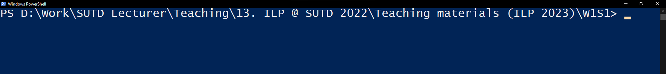
OS mode vs. Python mode
After installing Python, you may use the console to type Windows/Mac/OS commands (a.k.a. OS mode)
Typically, commands for creating, copying, pasting, moving through folders or files, etc.
You may also use a command to start a Python environment.
While in the Python environment or Python mode, your console expects Python-type commands (not OS ones!).
Line starts with current file folder description (= OS mode)

Slide 48
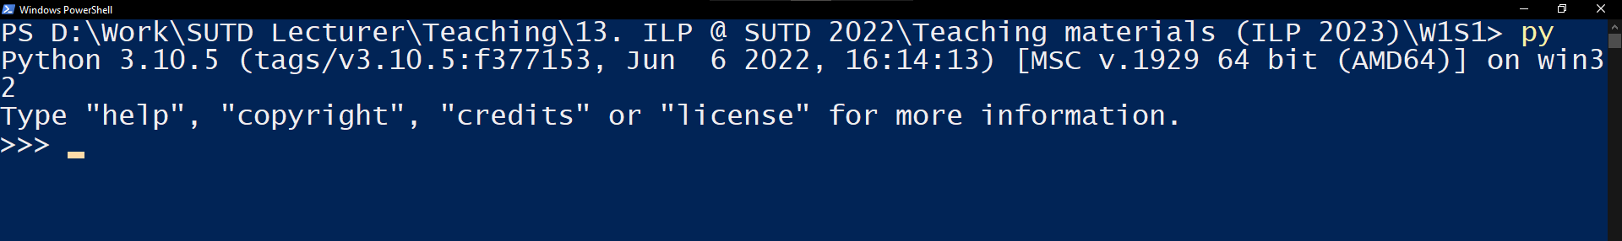
OS mode vs. Python mode
After installing Python, you may use the console to type Windows/Mac/OS commands (a.k.a. OS mode)
Typically, commands for creating, copying, pasting, moving through folders or files, etc.
You may also use a command to start a Python environment.
While in the Python environment or Python mode, your console expects Python-type commands (not OS ones!).
Line starts with three arrows (= Python mode)

Slide 49
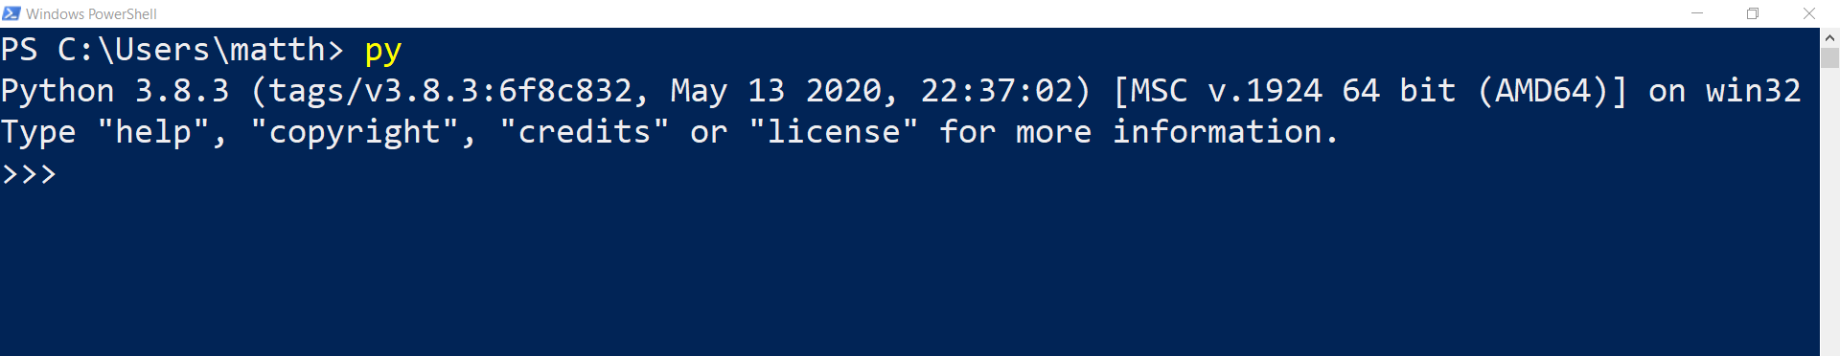
Your first run of Python!
Start Python by typing one of the following commands in the console, while in OS mode and press Enter!
(Note: one of these should work, might vary depending on your machine!)
py (most frequent one, works in my case)
py3
python
python3

Slide 50
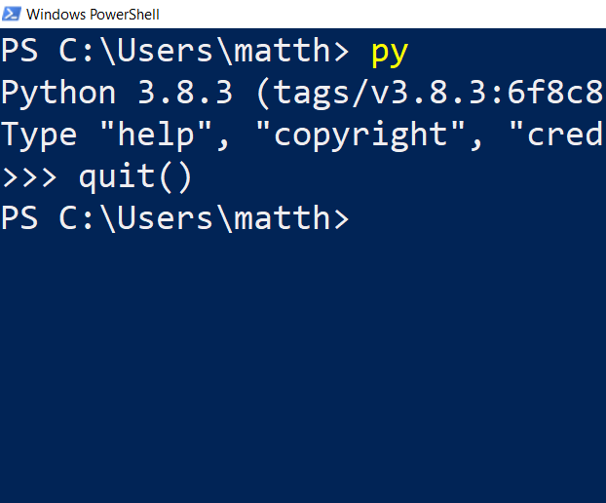
Your first run of Python!
Start Python by typing one of the following commands in the console, while in OS mode and press Enter!
(Note: one of these should work, might vary depending on your machine!)
py (most frequent one, works in my case)
py3
python
python3
To exit the Python environment and go back to your OS console, simply type quit() and press enter.

Slide 51
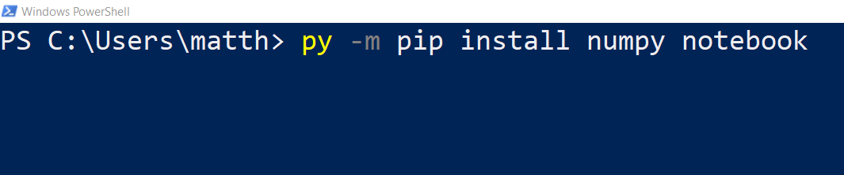
Installing & updating packages in Python
Next, let us install packages. (Packages are extra functionalities for Python.)

Slide 52
Installing & updating packages in Python
Next, let us install packages. (Packages are extra functionalities for Python.)
To do so, run the following command in your console, while in the OS mode.
py –m pip install numpy notebook
Note: if you are using py3, python or python3 instead of py, adjust accordingly!

Slide 53
Installing & updating packages in Python
Next, let us install packages. (Packages are extra functionalities for Python.)
To do so, run the following command in your console, while in the OS mode.
py –m pip install numpy notebook
Note: if you are using py3, python or python3 instead of py, adjust accordingly!
It shall run for a while, download and install a few things… (numpy for advanced math computation and notebook, which we will use later on)

Slide 54
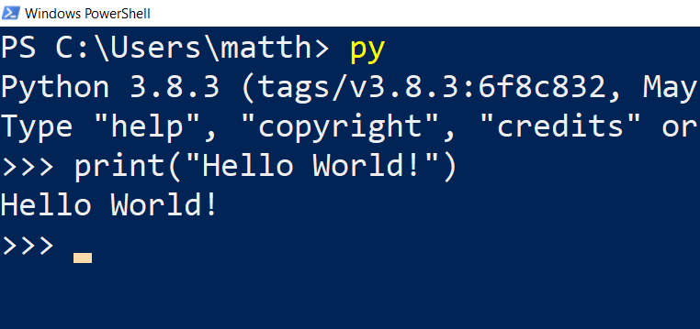
Our first program!
Start python in a console, type print(“Hello World!”), and submit by pressing Enter. It should display “Hello World!”.

Slide 55
Our first program!
Start python in a console, type print(“Hello World!”), and submit by pressing Enter. It should display “Hello World!”.
Definition (the “Hello World” program): The “Hello World” program is a computer program that outputs or displays the message "Hello World!". It is often used as a sanity test to make sure that a computer language is correctly installed.

Slide 56
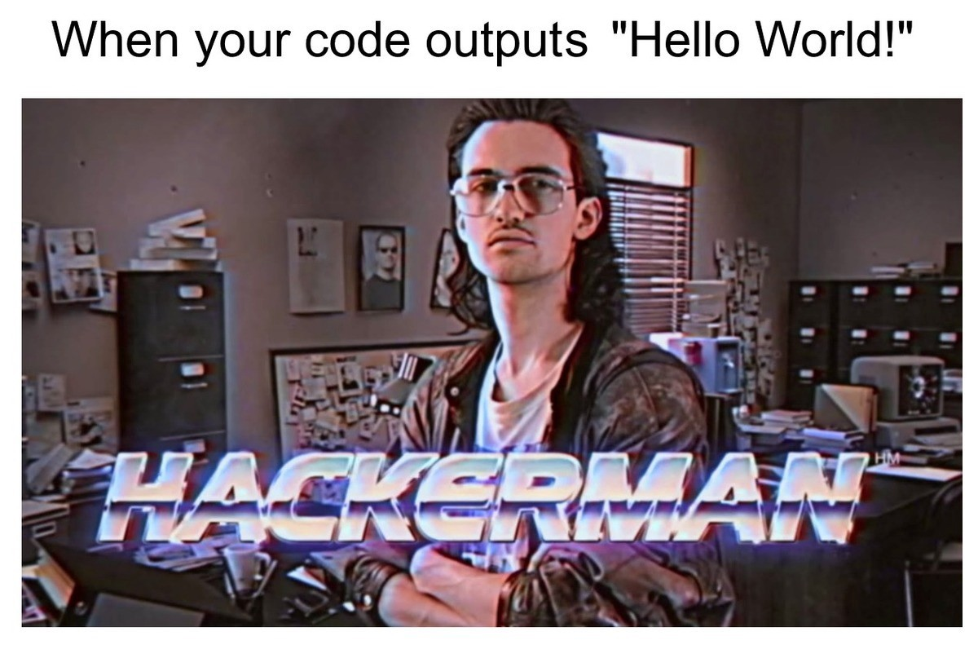
Our first program!
Start python in a console, type print(“Hello World!”), and submit by pressing Enter. It should display “Hello World!”.
Definition (the “Hello World” program): The “Hello World” program is a computer program that outputs or displays the message "Hello World!". It is often used as a sanity test to make sure that a computer language is correctly installed.

Slide 57
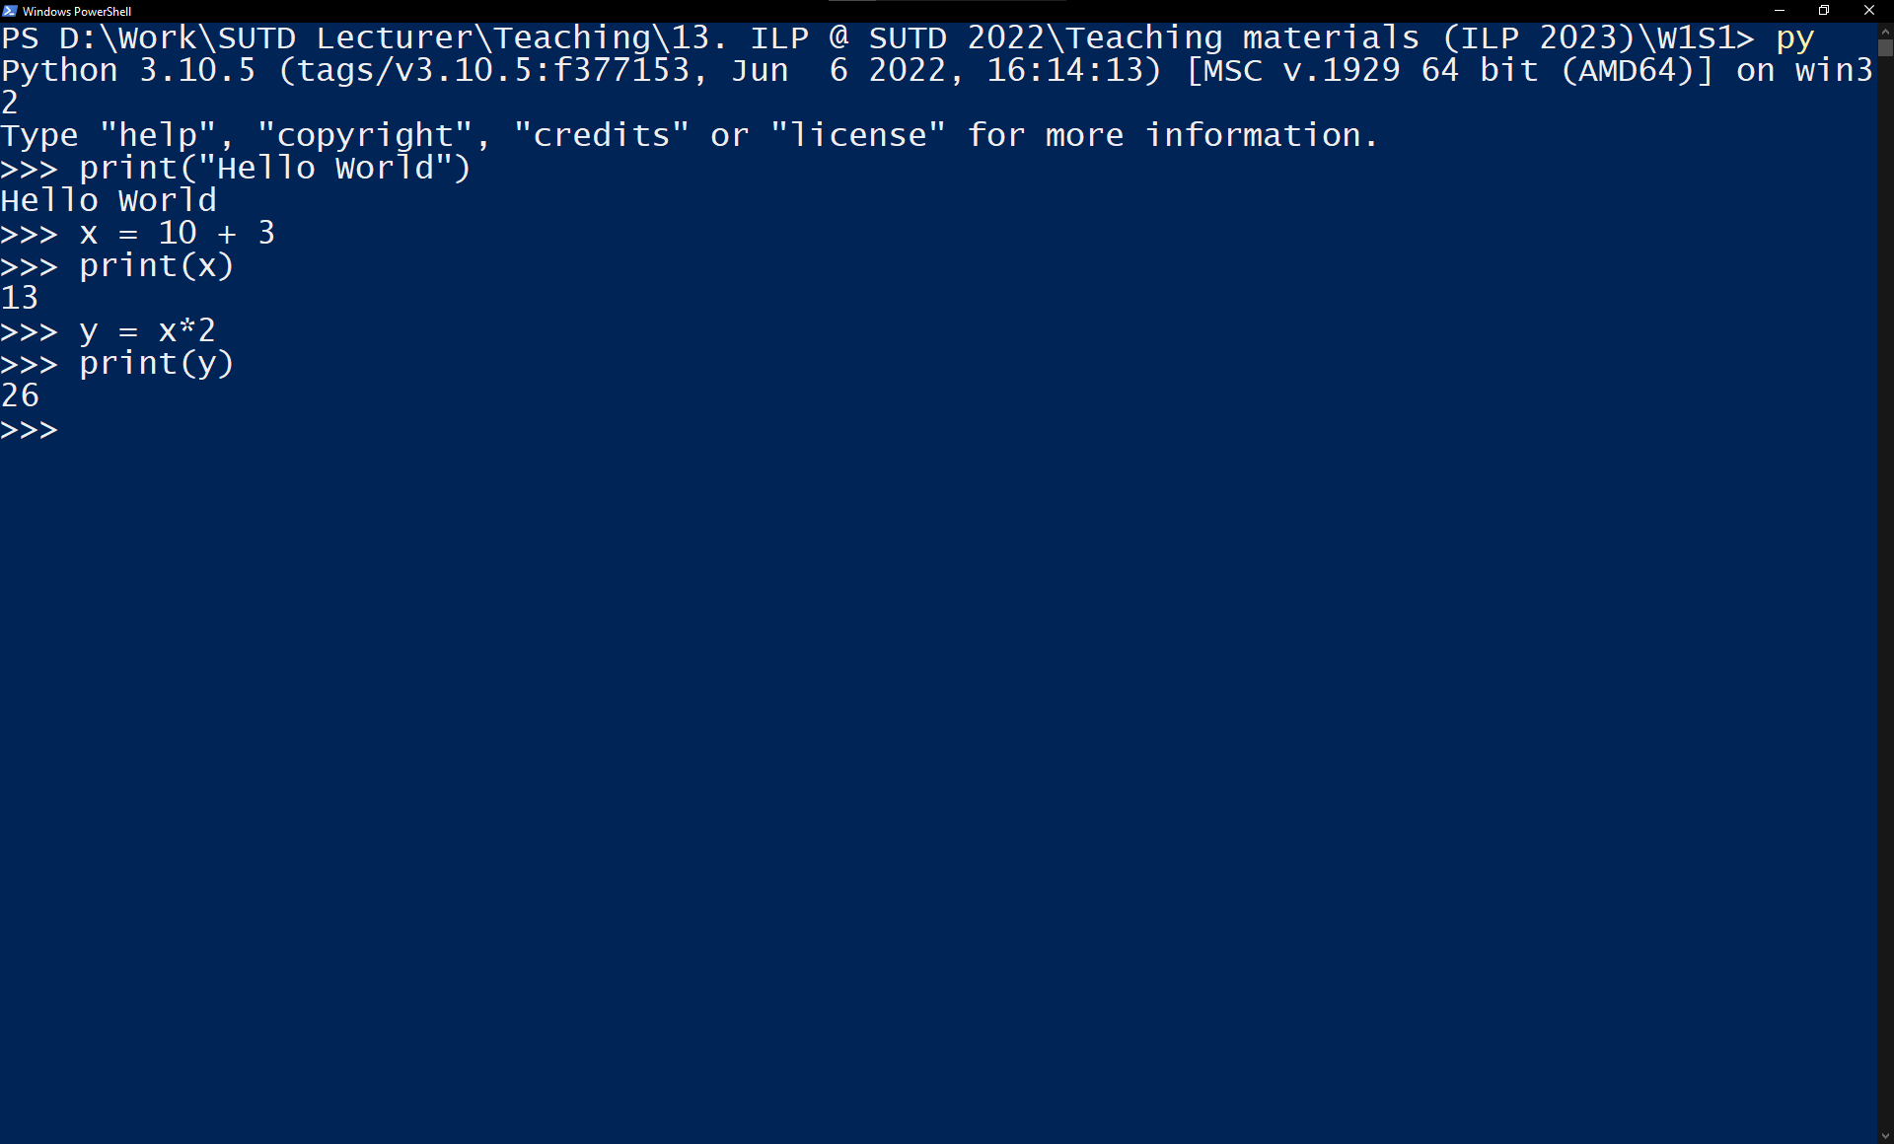
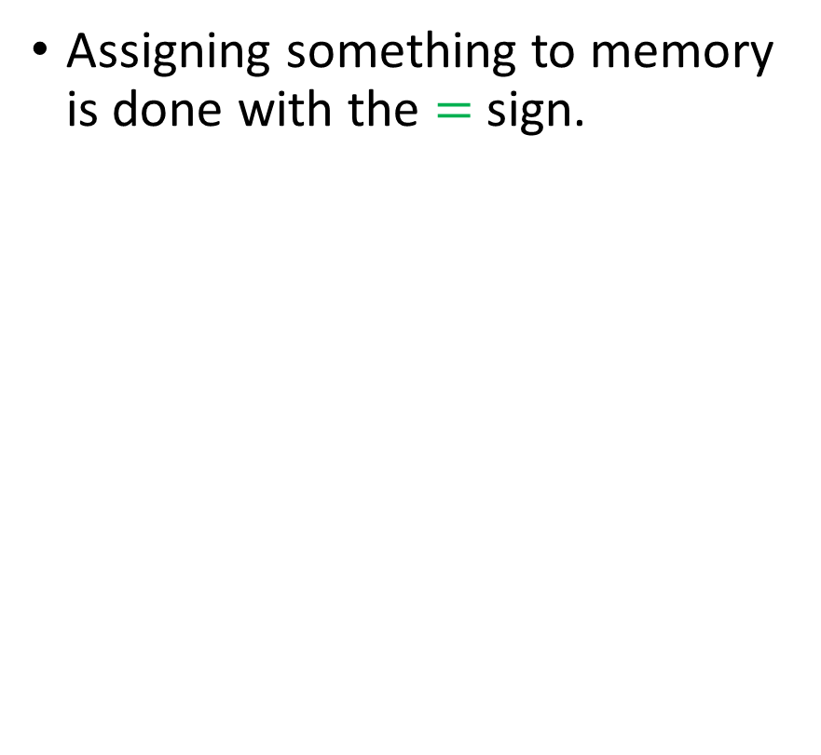
Our first program!
Assigning something to memory is done with the $=$ sign.

Slide 58
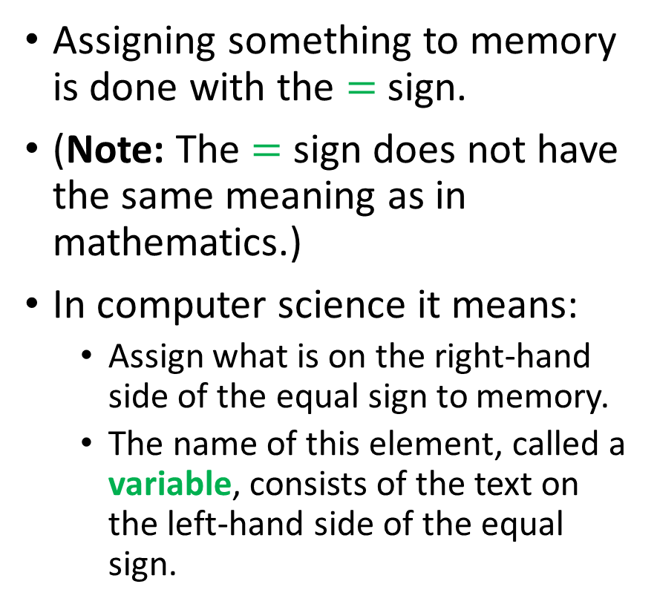
Our first program!
Assigning something to memory is done with the $=$ sign.
(Note: The $=$ sign does not have the same meaning as in mathematics.)
In computer science it means:
Assign what is on the right-hand side of the equal sign to memory.
The name of this element, called a variable, consists of the text on the left-hand side of the equal sign.

Slide 59
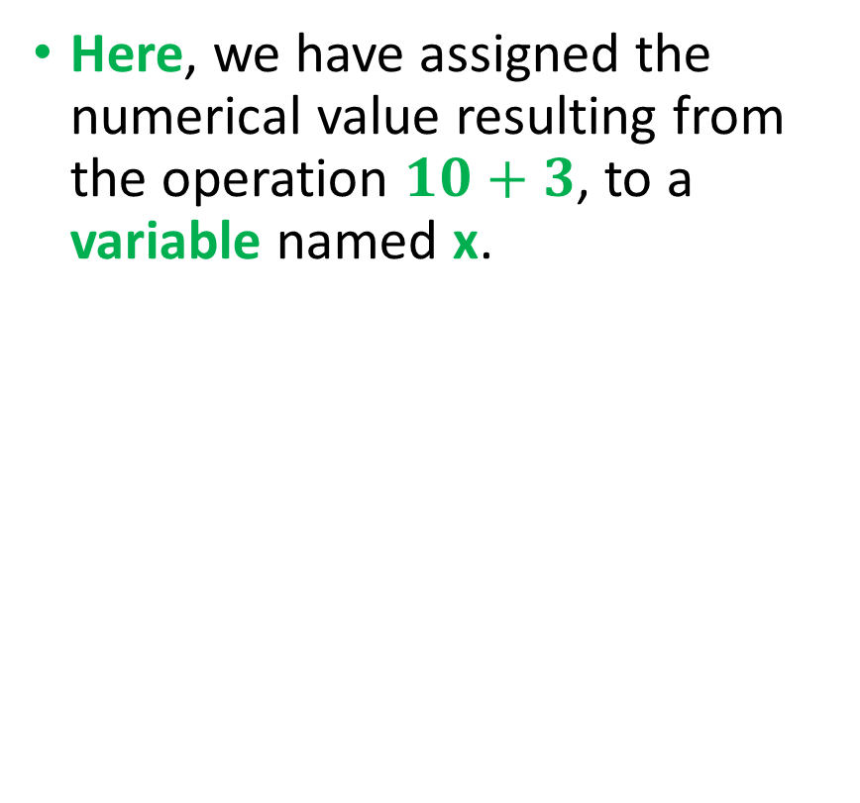
Our first program!
Here, we have assigned the numerical value resulting from the operation $10+3$, to a variable named x.

Slide 60
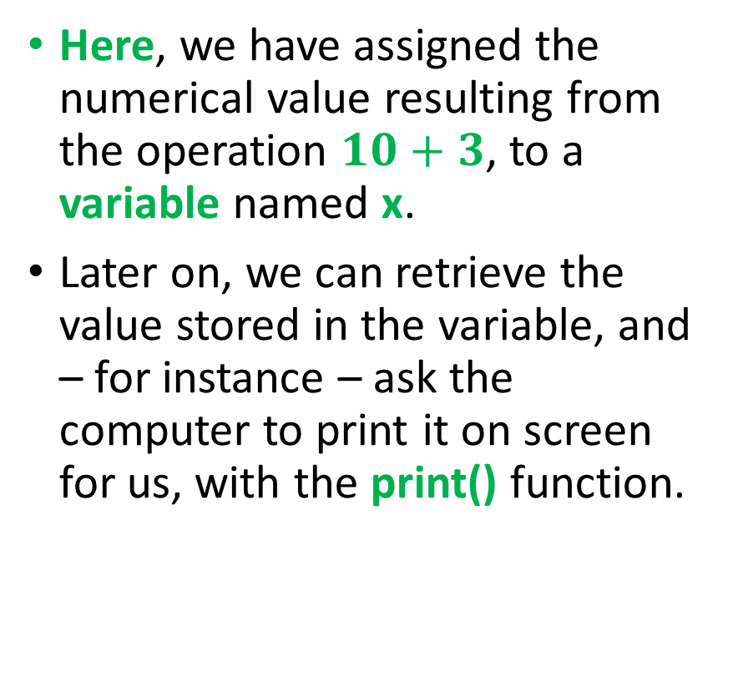
Our first program!
Here, we have assigned the numerical value resulting from the operation $10+3$, to a variable named x.
Later on, we can retrieve the value stored in the variable, and – for instance – ask the computer to print it on screen for us, with the print() function.

Slide 61
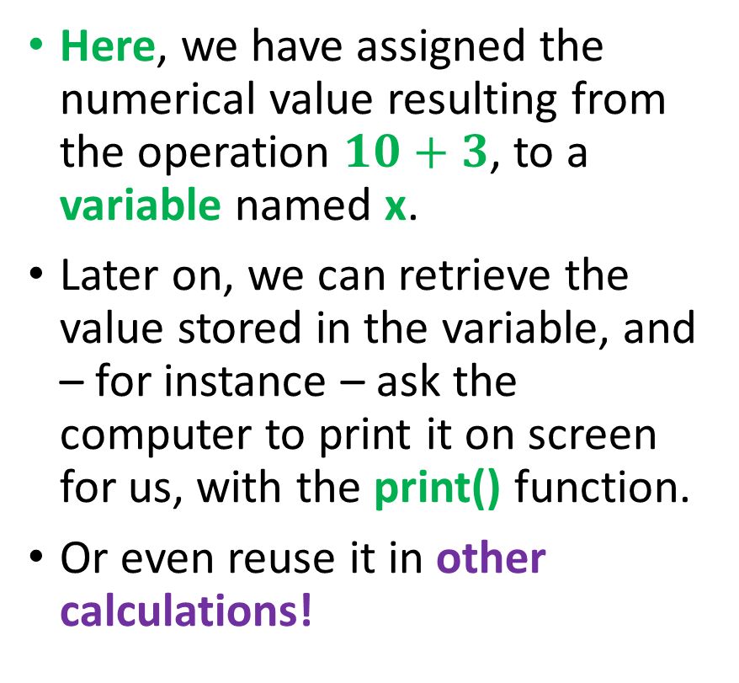
Our first program!
Here, we have assigned the numerical value resulting from the operation $10+3$, to a variable named x.
Later on, we can retrieve the value stored in the variable, and – for instance – ask the computer to print it on screen for us, with the print() function.
Or even reuse it in other calculations!

Slide 62

Our first program!
Here, we have assigned the numerical value resulting from the operation $10+3$, to a variable named x.
Later on, we can retrieve the value stored in the variable, and – for instance – ask the computer to print it on screen for us, with the print() function.
Or even reuse it in other calculations!
Important: these commands executed in the background but showed nothing in the console!
Need to explicitly ask for a print()!

Slide 63
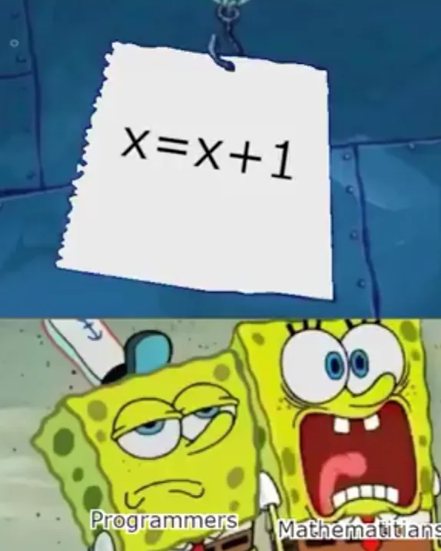
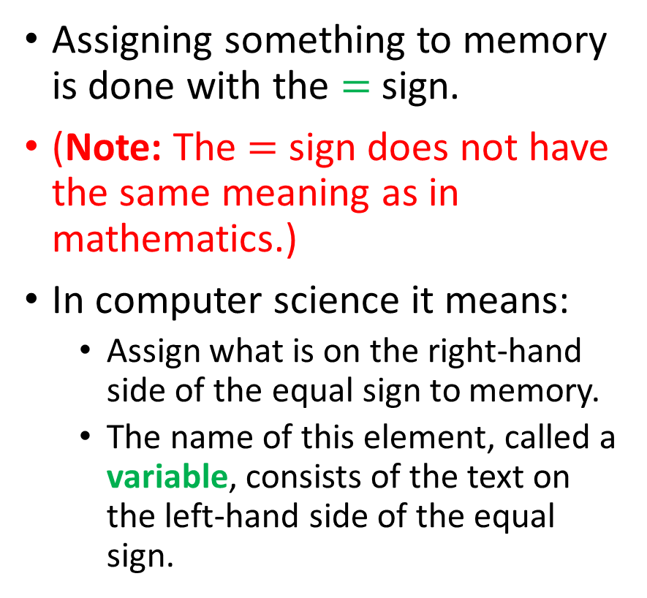
Our first program!
Assigning something to memory is done with the $=$ sign.
(Note: The $=$ sign does not have the same meaning as in mathematics.)
In computer science it means:
Assign what is on the right-hand side of the equal sign to memory.
The name of this element, called a variable, consists of the text on the left-hand side of the equal sign.
An important note on the use of the equal sign in computer science.

Slide 64

Matt’s Great advice #1
Matt’s Great Advice #1: the print() function in Python.
The print() function is the most important Python function.
It is only way for you to check what is being computed and stored in memory at any given time.
Use it and abuse it, to check what your program is doing!

Slide 65
Executing a .py file in console mode
You should have downloaded a few files along with the lecture notes on eDimension.
More specifically, we will now use the first_program.py file.

Slide 66
Executing a .py file in console mode
You should have downloaded a few files along with the lecture notes on eDimension.
More specifically, we will now use the first_program.py file.
Identify where your first_program.py file is currently located, before moving to the next slide.

Slide 67
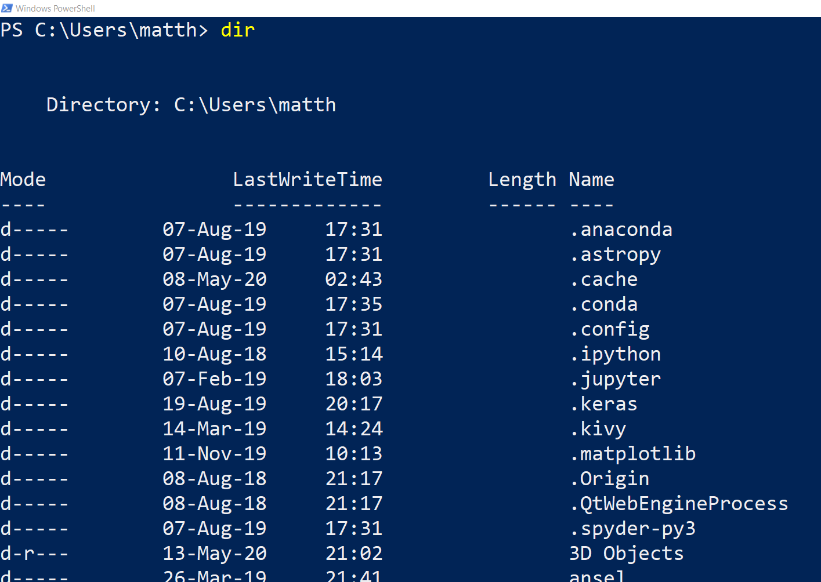
Executing a .py file in console mode
Current location is C:\Users\matth\
Command (dir/ls): The dir command (or ls command in Mac OS/Linux) lists the folders and files in your current location.

Slide 68
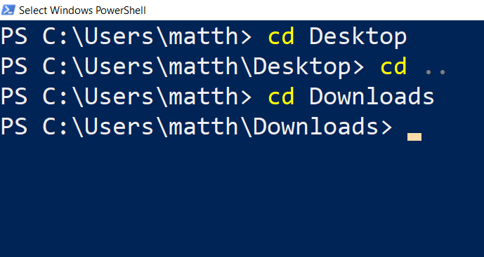
Executing a .py file in console mode
Command (dir/ls): The dir command (or ls command in Mac OS/Linux) lists the folders and files in your current location.
Command (cd): The cd command changes your current location to another folder, reachable from your current location in dir/ls.
Observe how the current location is changing every time.

Slide 69
Executing a .py file in console mode
Command (dir/ls): The dir command (or ls command in Mac OS/Linux) lists the folders and files in your current location.
Command (cd): The cd command changes your current location to another folder, reachable from your current location in dir/ls.
Note: the command “cd ..” moves you back one level.
Observe how the current location is changing every time.

Slide 70
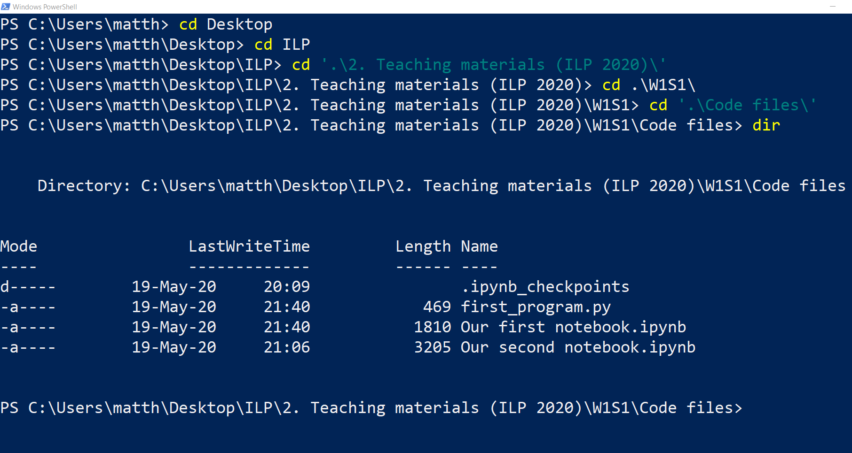
→ Now, use cd/dir/ls commands to move to the location of your first_program.py file !

Slide 71
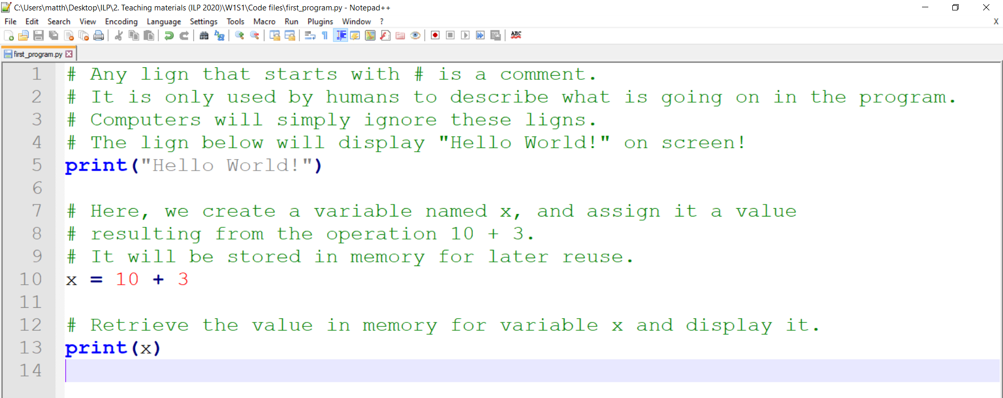
Checking your .py file
Open your first_program.py file with any text editor (specifically do it by right clicking and asking to open with a text editor).
Recognize the code we used earlier.

Slide 72
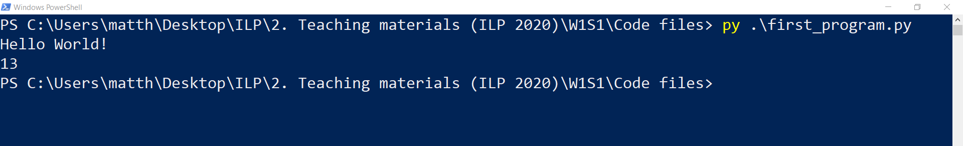
Checking your .py file
Open your first_program.py file with any text editor (specifically do it by right clicking and asking to open with a text editor).
Recognize the code we used earlier.
Later on, you can run the code in the first_program.py file, all at once, by typing the following command in your console
py first_program.py

Slide 73
Running Python from an IDE
Problem: Typing code in a text editor and running it from console is not exactly convenient…

Slide 74
Running Python from an IDE
Problem: Typing code in a text editor and running it from console is not exactly convenient…
Suggestion: we should use an Interactive Development Environment (IDE), which makes the coding easier for us.

Slide 75
Running Python from an IDE
Problem: Typing code in a text editor and running it from console is not exactly convenient…
Suggestion: we should use an Interactive Development Environment (IDE), which makes the coding easier for us.
In this course, I suggest to use Jupyter Notebook, but you might look online for other IDEs if you want!

Slide 76
Running Python from an IDE, such as a Jupyter Notebook
Return to your console, outside of the Python environment (use quit() if needed).

Slide 77
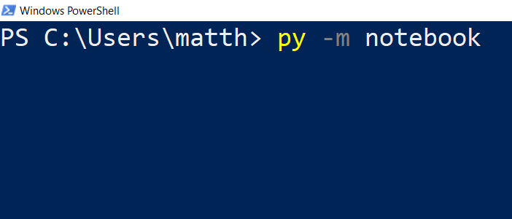
Running Python from an IDE, such as a Jupyter Notebook
Return to your console, outside of the Python environment (use quit() if needed).
Type py –m notebook, and press enter to submit and call the Python notebook module (-m notebook)

Slide 78
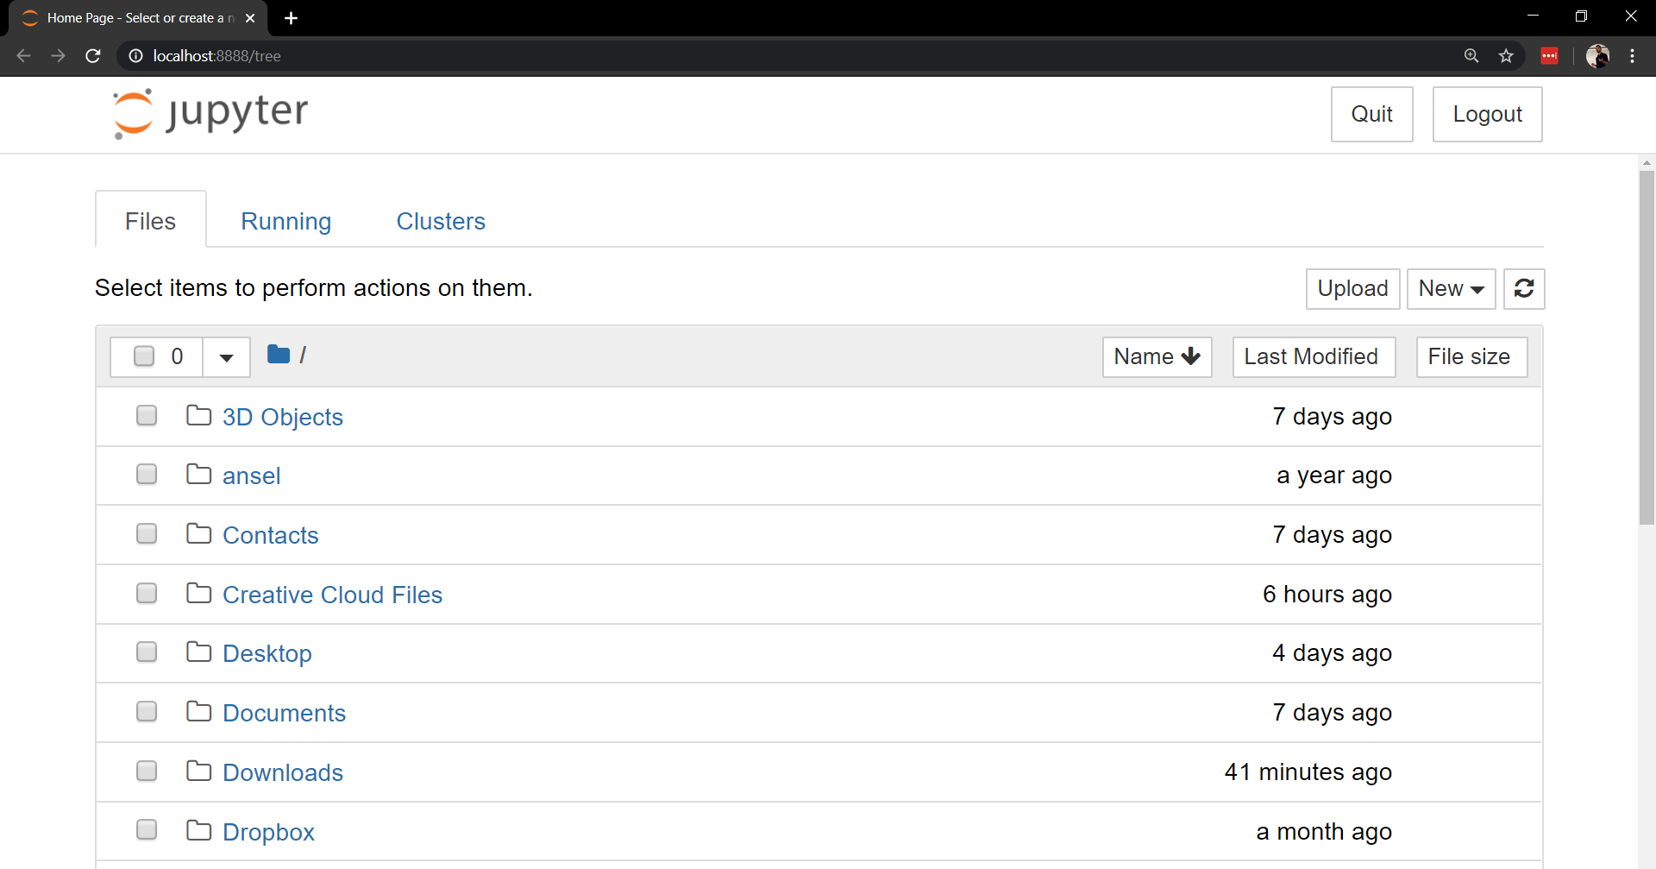
Running Python from an IDE, such as a Jupyter Notebook
Return to your console, outside of the Python environment (use quit() if needed).
Type py –m notebook, and press enter to submit and call the Python notebook module (-m notebook)
It should open a notebook window/tab in your web browser.

Slide 79
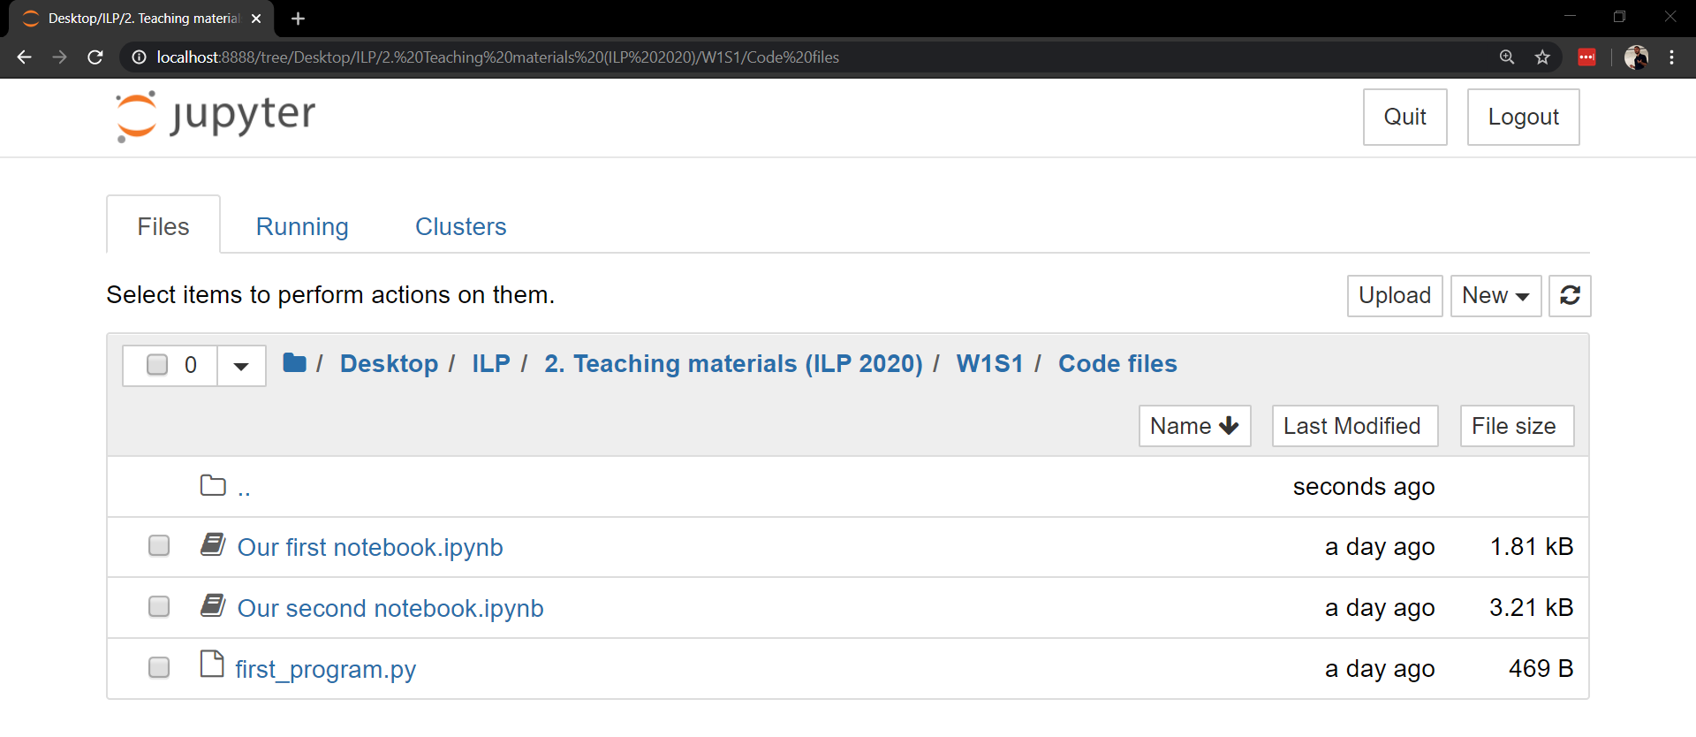
Running Python from an IDE, such as a Jupyter Notebook
Notebooks are a more convenient way to program on Python.
They provide an explorer to navigate to a folder of your choice.
Move to the folder where the code you downloaded is.

Slide 80

Running Python from an IDE, such as a Jupyter Notebook
Notebooks provide a mixed combination of
text blocks (in Markdown language)
and code blocks (in Python, these blocks have a “In […]” on their left side).

Slide 81
Running Python from an IDE, such as a Jupyter Notebook
Notebooks provide a mixed combination of
text blocks (in Markdown language)
and code blocks (in Python, these blocks have a “In […]” on their left side).
Try executing a cell of code by selecting it and pressing Shift+Enter!
A lot more convenient isn’t it?

Slide 82

Our second task
Let us consider a second task: compute the area of a circle with radius 10.
Open the second notebook.

Slide 83

Our second task
Let us consider a second task: compute the area of a circle with radius 10.
Open the second notebook.
Note: in computer science, the multiplication operation is denoted $∗$, not $×$.

Slide 84

Our second task: problem
While the task seems easy mathematically speaking, we have a problem…
→ We need the value of pi.

Slide 85
Our second task: problem
While the task seems easy mathematically speaking, we have a problem…
→ We need the value of pi.
We could create a variable named pi and assign it the value 3.14, but it is better (and more accurate) to retrieve it from a package.

Slide 86

Importing from a Python package
By default, Python is a simple yet powerful calculator, which can only perform basic calculations (additions, multiplications, etc.)

Slide 87
Importing from a Python package
By default, Python is a simple yet powerful calculator, which can only perform basic calculations (additions, multiplications, etc.)
If we need more advanced concepts, we need to import them from a package.

Slide 88


Importing from a Python package
By default, Python is a simple yet powerful calculator, which can only perform basic calculations (additions, multiplications, etc.)
If we need more advanced concepts, we need to import them from a package.
Import $≈$ adding a specific button to your calculator.

Slide 89


Importing from a Python package
By default, Python is a simple yet powerful calculator, which can only perform basic calculations (additions, multiplications, etc.)
If we need more advanced concepts, we need to import them from a package.
Import $≈$ adding a set of buttons/functions to your calculator.

Slide 90

By the way, this means that you do not need your calculator anymore, welcome to the real world.

Slide 91
Congratulations, you now have a Python-compatible machine, ready to run!
Feel free to play around a bit more if you want!

Slide 92
Conclusion
What we have seen
What is programming?
Programming Languages and why we will use Python.
Installing Python, extra packages and IDEs.
Test run to confirm everything works.
→ If you were able to execute the two codes (in console and Jupyter Notebooks): you are officially done for today.
→ Let me know ASAP if you have encountered technical issues and we will try to fix them together.

